Slide 1

Sales Data Analysis – Customer & Product Insights
Sample Superstore Sales Dataset
Comprehensive Data Analysis Project

Slide 2
Project Overview
Dataset: Sample Superstore Sales Dataset
Objective: Improve sales performance and customer satisfaction by analyzing sales data.
Tools: Python (Pandas, Seaborn, Matplotlib), SQL (MySQL Workbench)
Scope: Data Cleaning, EDA, SQL Analysis, Visualization, Statistics

Slide 3
Step 1: Data Cleaning
Combined duplicate lines by grouping on Order ID & Product ID.
Aggregated Sales, Profit, Quantity accurately.
Recalculated Profit Margin.
Checked categorical consistency (e.g., Segment, Category).
Exported cleaned dataset for analysis.

Slide 4
Step 2: Exploratory Data Analysis (EDA)
Descriptive statistics: Mean, Min, Max, Std for numeric fields.
Univariate & bivariate analysis: Sales, Profit, Quantity.
Region & Category trends: Sales & Profit by Region/Category.
Ship Mode trends.
Correlation checks: e.g., Discount vs Profit.

Slide 5
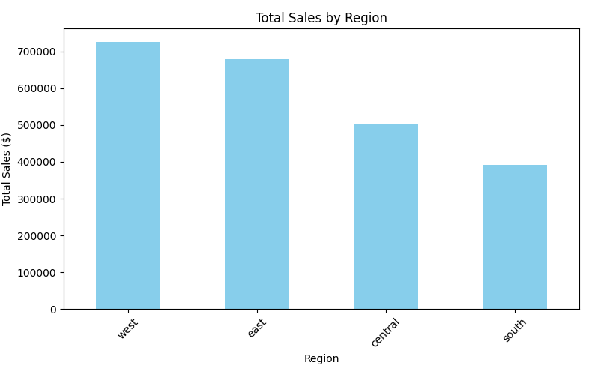
Univariate & bivariate analysis: Sales, Profit, Quantity.

Slide 6
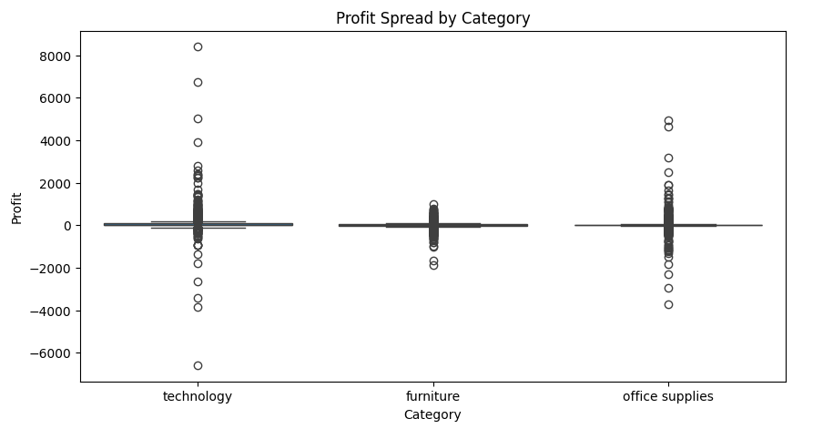
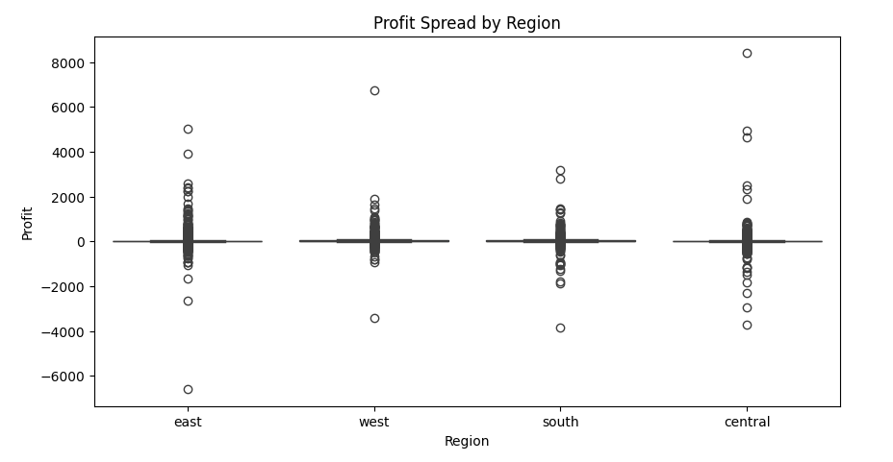
Region & Category trend

Slide 7
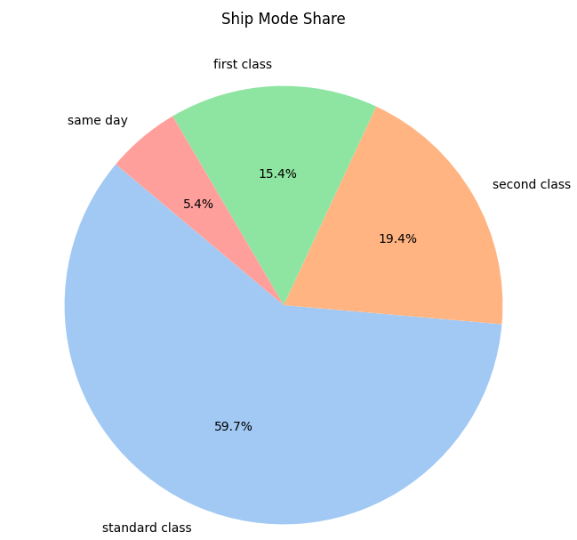
Ship Mode trends

Slide 8
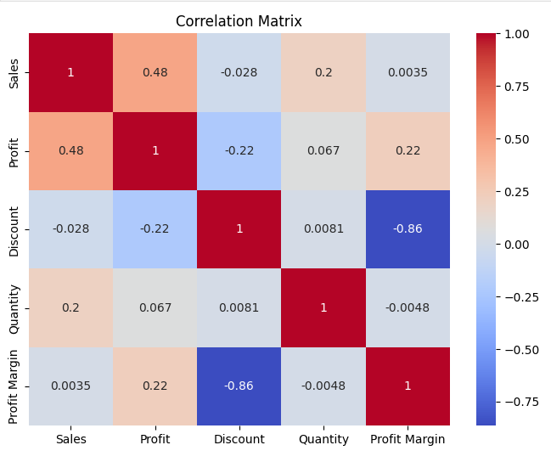
Correlation checks

Slide 9
Key EDA Visuals
Barplots: Sales/Profit by Region, Category, Sub-Category.
Histograms: Profit, Quantity distributions.
Boxplots: Profit spread.
Correlation Heatmaps.
Time Trend Analysis.

Slide 10
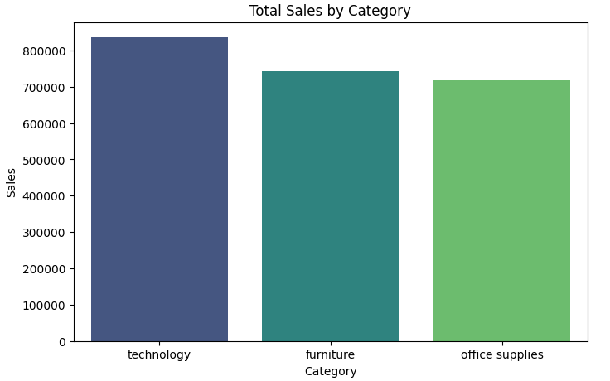
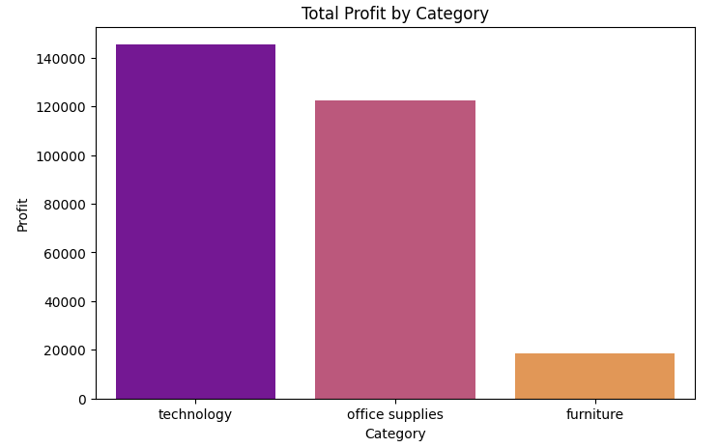
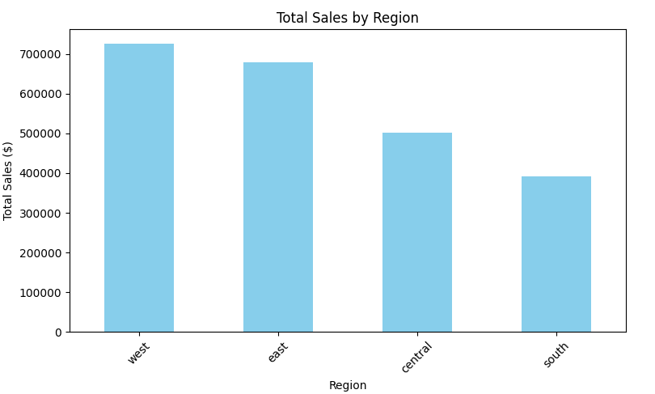
Barplots: Sales by Region, Category, Sub-Category.

Slide 11
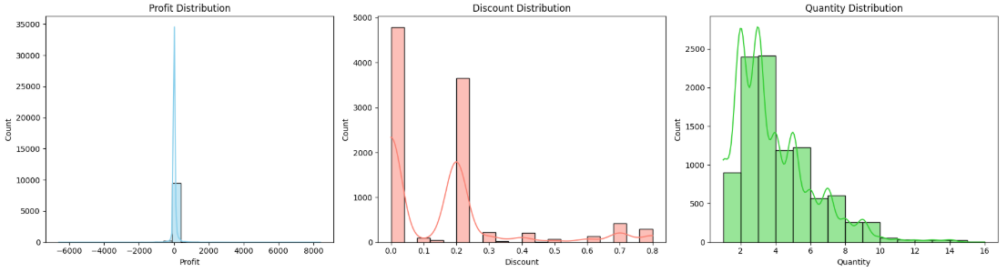
Histograms: Profit, Quantity distributions.

Slide 12
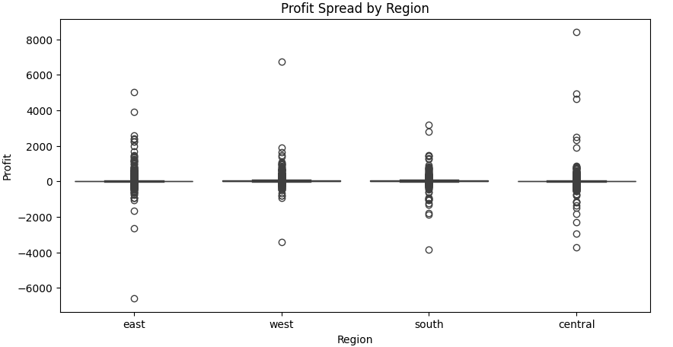
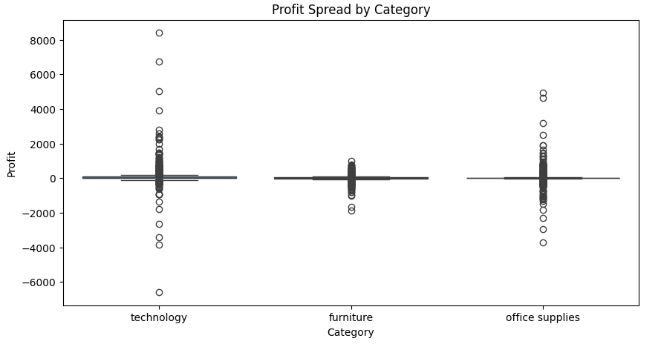
Boxplots: Profit spread

Slide 13
Step 3: SQL Analysis
Created MySQL database & imported cleaned data.
Basic Queries: Sales by Region, Category, State.
Joins, Aggregations: Customer Orders, Product Performance.
Window Functions: Ranking Top N products, LAG, LEAD.
Advanced CTEs & Subqueries for deep insights.

Slide 14
Step 4: Visualizations
Additional visual charts:
Lineplot: Sales trends over months.
Heatmap: Correlation matrix.
Histogram: Discount/Profit distributions.
Boxplots: Profit spread by Region/Category.
Barplot: Top customers by Sales/Profit.

Slide 15
Key Insights
West & East regions generate the highest sales.
Technology category is top-performing in profit.
Some states show high sales but negative profit.
High discount levels can impact profit negatively.
Standard Class is the most common shipping mode.

Slide 16
Recommendations
Focus marketing on profitable states and product lines.
Re-evaluate discount strategies to protect margins.
Optimize logistics for cost-effective shipping.
Expand successful product categories.
Continuously monitor trends for proactive actions.

Slide 17
Thank You!
Questions & Discussion

